Slide 1



Know Your Brew!
Saifee, Courtney, Sarah and Aparna

Slide 2
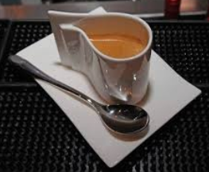
Project Overview
Our project goal is to start a coffee business and set up a website for that purpose.
Key areas:
Worldwide trend in Coffee production and export
Using YELP API to find coffee places nearby and allow users to sort by rating, review count and distance. Also plotting the fetched places on the map and providing yelp page link for more details.
Using Twitter API to find latest tweets related to coffee
Scrapping website to get latest coffee news
Displaying coffee trends through images

Slide 3

Data Sources
ICO Historical Data on the Global Coffee Trade for the year of 2016 and 2017
Yelp API
Twitter API
DailyCoffeeNews.com
National Coffee Association USA

Slide 4

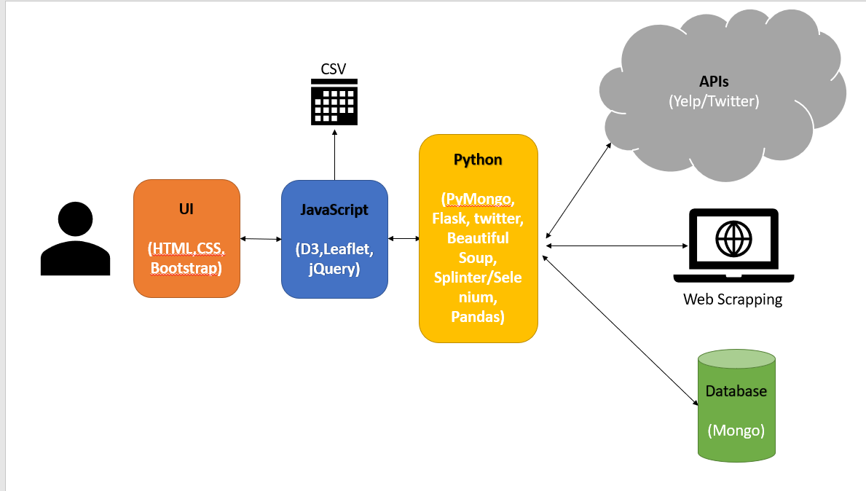
Data Flow & Architecture

Slide 5
Data Sources and Analysis Approach
Explored global trends in coffee production and export using International Coffee Organization (ICO) annual report on Global Coffee Trade for the year of 2016 and 2017
ICO is the main intergovernmental organization for coffee market, representing almost entire coffee production market and committed to improving the coffee economy through international co-operation.
Found the exact ICO data in compiled & organized format (production and export) in kaggle website
Sort csv based on production, added four columns: latitude, longitude, ranks and radius size
Convert csv to GeoJson format

Slide 6

Data handling challenges
As is GeoJson data
Cleaned up GeoJson data
{
"type": "Feature",
"geometry": {
"type": "Point",
"coordinates": [ -74.297333,4.570868 ]
},
"properties": {
"rank":3,
"country":"Colombia",
"production":14634,
"export":12898
}
},
{
"rank":3,
"country":"Colombia",
"coordinates": [ 4.570868,-74.297333 ],
"production":14634,
"export":12898,
"radSize":20
},

Slide 7
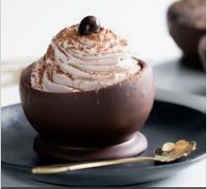
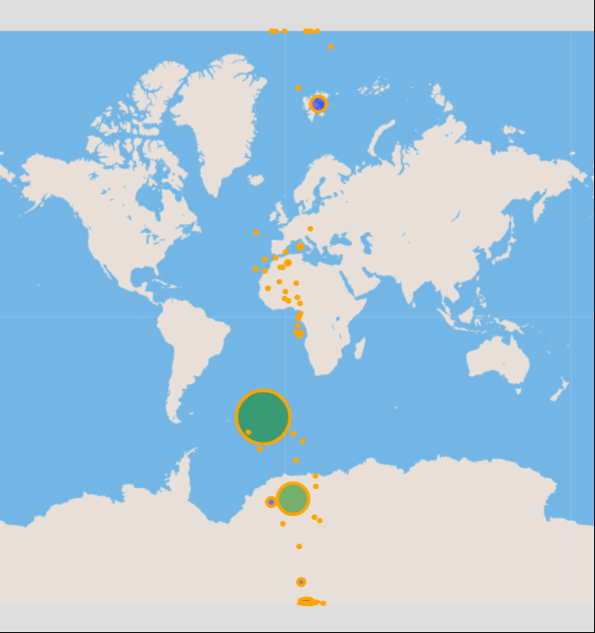
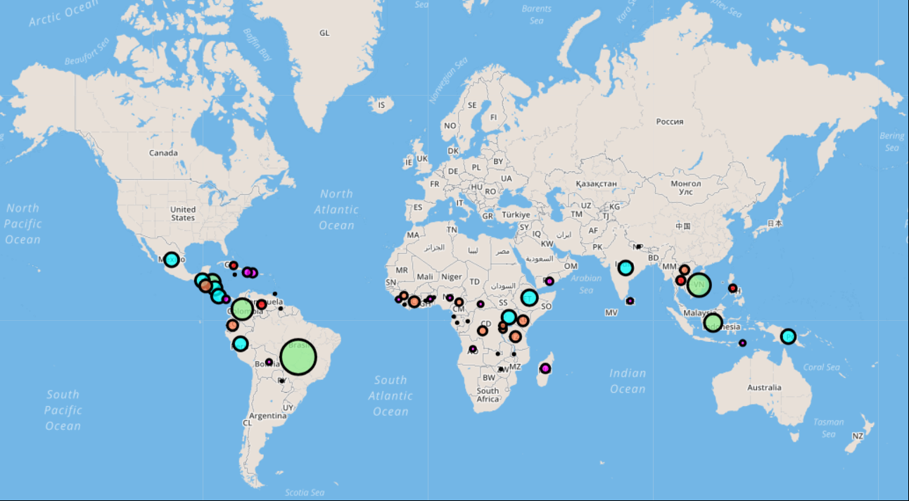
Difficulties

Slide 8

Difficulties
Yelp API:
We were planning to tap the Yelp API through Javascript directly and faced authorization issues. However, after lots of R&D and with Rob’s help ☺, we got to know that Yelp does not allow clients to invoke the APIs through a frontend platform like Javascript. We then pivoted to call the API through backend (Python)
Reference: https://github.com/Yelp/yelp-fusion/issues/386
Web Page Navigations:
As the entire application is hosted on flask, we could not navigate between different html pages just by providing <href> attribute to the navigation items. We identified later that each <href> would need to be added as an app route in the python file which would then render that html.

Slide 9

Difficulties (continued)
Front Page Webscrape:
The goal for the front page webscrape was to scrape the text and images from the source websites. We were successful in scraping the text after several debugging sessions and assistance from Rob and Kevin. However, the syntax for scraping the images from the source websites was a more challenging task. We quickly adjusted our plan of execution and added the images to the index.html file to meet the project deadline.

Slide 10

Resources
https://developers.google.com/public-data/docs/canonical/countries_csv (latlon)
http://www.convertcsv.com/csv-to-geojson.htm (csv converter)
https://www.kaggle.com/sbajew/icos-crop-data (ICO-cleaned data)
http://www.ico.org/new_historical.asp
http://www.ncausa.org/about-coffee/coffee-around-the-world
http://www.most-expensive.coffee/
https://financesonline.com/top-10-most-expensive-coffee-in-the-world-luwak-coffee-is-not-the-no-1/
https://www.worldatlas.com/articles/top-coffee-producing-countries.html
https://www.yelp.com/developers/documentation/v3/business_search
https://developer.twitter.com/en/docs/tweets/search/api-reference/get-search-tweets.html
https://dailycoffeenews.com

Slide 11

Future Direction
Selecting perfect locations to open coffee shops across USA with the flavors/ types that people like the most based off of the yelp and tweet feedback from users.

Slide 12



Slide 13

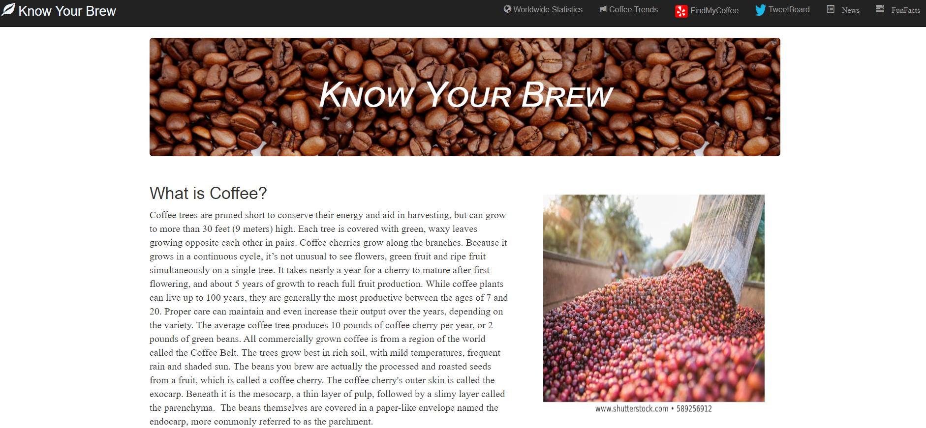
Front Webpage

Slide 14
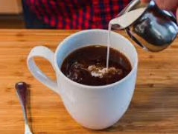
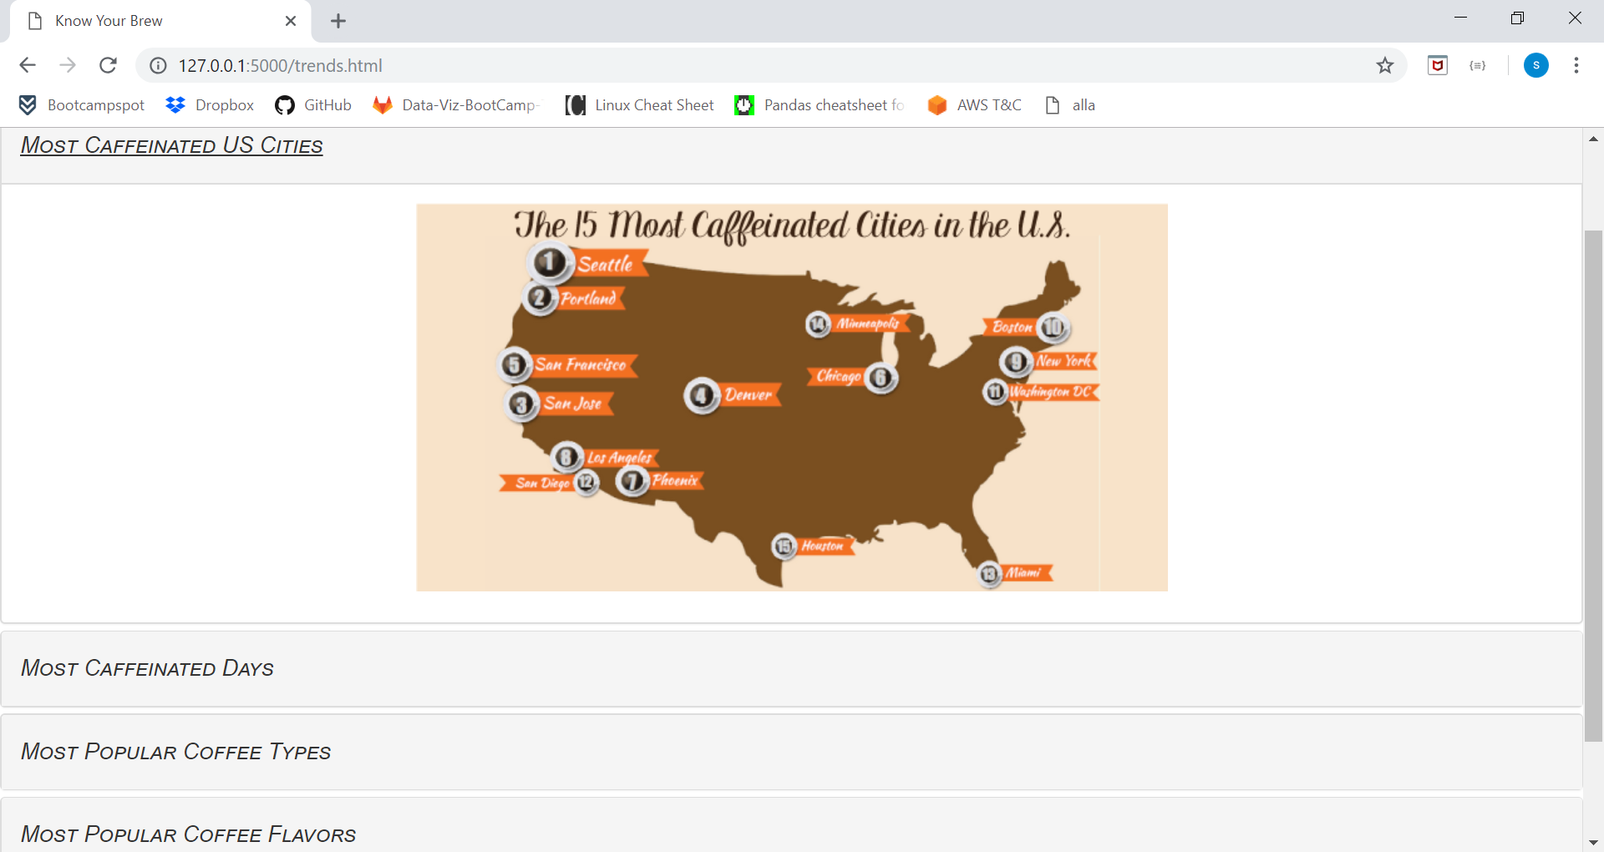
Coffee Trends

Slide 15

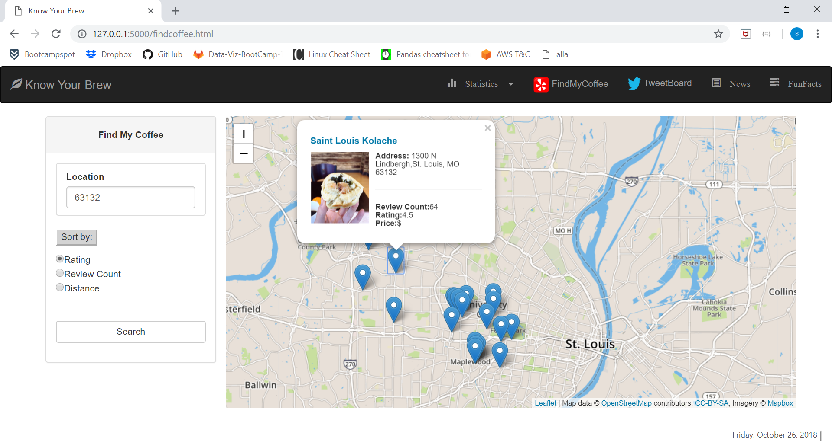
FindMyCoffee (Yelp API)

Slide 16
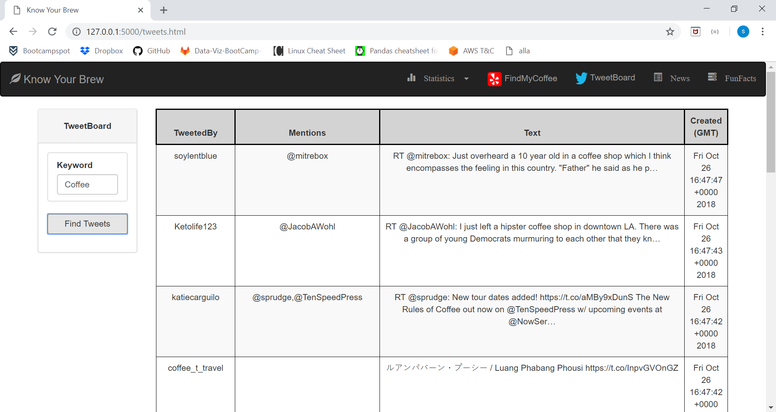
TweetBoard (Twitter API)

Slide 17
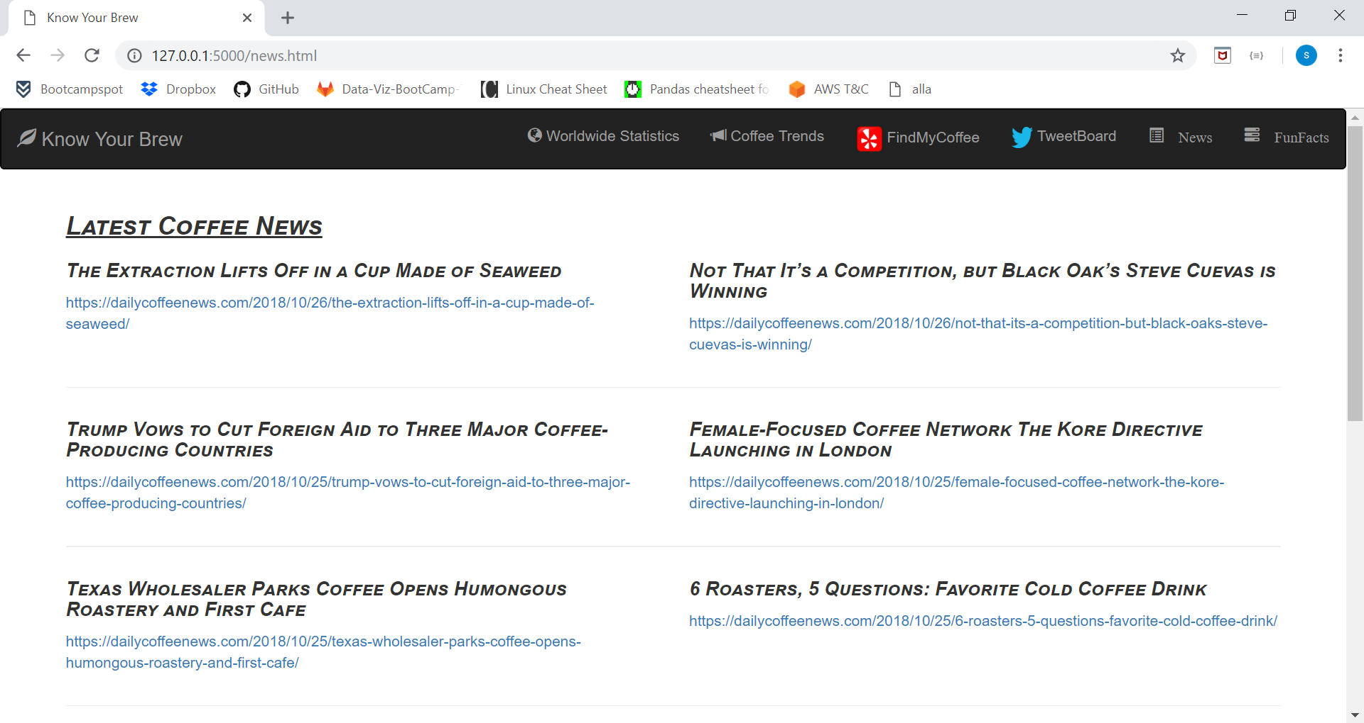
Coffee News

Slide 18
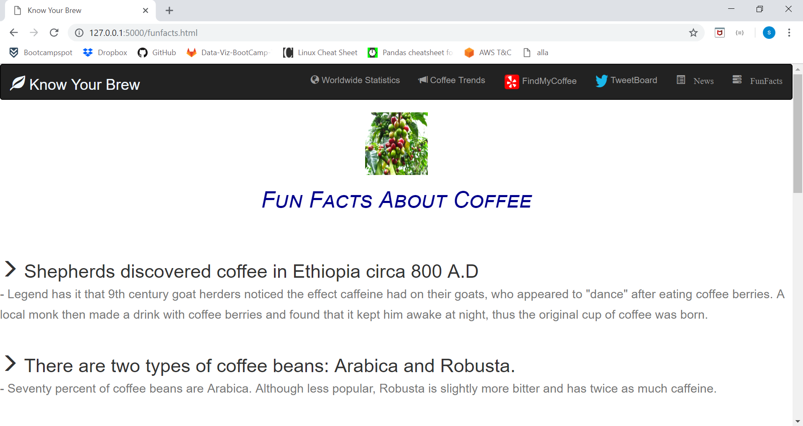
Fun Facts

